Slide 1
Register Transfer and Micro-operations <number>
Overview
Register Transfer Language
Register Transfer
Bus and Memory Transfers
Arithmetic Micro-operations
Logic Micro-operations
Shift Micro-operations
Arithmetic Logic Shift Unit
CSE 211

Slide 2
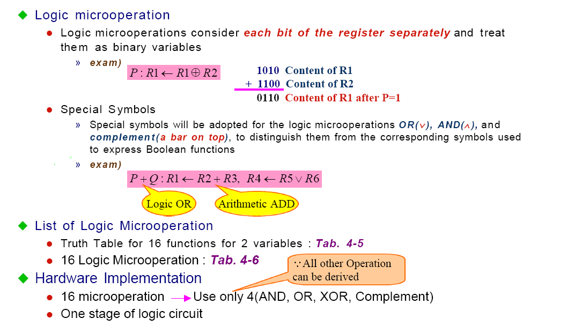
Register Transfer and Micro-operations <number>
Logic Micro operations
CSE 211

Slide 3
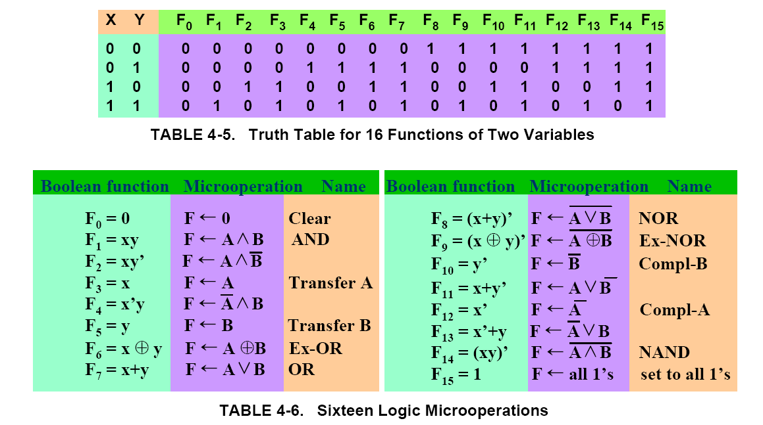
Register Transfer and Micro-operations <number>
Logic Microoperations
CSE 211

Slide 4
Register Transfer and Micro-operations <number>
Hardware Implementation
A
i
0
B
i
1
4 X 1
F
MUX
i
2
3
Select
S
1
S
0
Function table
S₁ S₀
Output
μ-operation
0 0 F = A ∧ B AND
0 1 F = A ∨ B OR
1 0 F = A ⊕ B XOR
1 1 F = A’ Complement
CSE 211

Slide 5
Register Transfer and Micro-operations <number>
Applications of Logic Microoperations
Logic microoperations can be used to manipulate individual bits or a portions of a word in a register
Consider the data in a register A. In another register, B, is bit data that will be used to modify the contents of A
  Selective-set A ← A + B
  Selective-complement A ← A ⊕ B
  Selective-clear A ← A • B’
  Mask (Delete) A ← A • B
  Clear A ← A ⊕ B
  Insert A ← (A • B) + C
  Compare A ← A ⊕ B
CSE 211

Slide 6
Register Transfer and Micro-operations <number>
Applications of Logic Microoperations
1. In a selective set operation, the bit pattern in B is used to set certain bits in A
1 1 0 0 A_{t}
1 0 1 0 B
1 1 1 0 A_{t+1} (A ← A + B)
If a bit in B is set to 1, that same position in A gets set to 1, otherwise that bit in A keeps its previous value
2. In a selective complement operation, the bit pattern in B is used to complement certain bits in A
1 1 0 0 A_{t}
1 0 1 0 B
0 1 1 0 A_{t+1} (A ← A ⊕ B)
If a bit in B is set to 1, that same position in A gets complemented from its original value, otherwise it is unchanged
CSE 211

Slide 7
Register Transfer and Micro-operations <number>
Applications of Logic Microoperations
3. In a selective clear operation, the bit pattern in B is used to clear certain bits in A
1 1 0 0 A_{t}
1 0 1 0 B
0 1 0 0 A_{t+1} (A ← A ⋅ B’)
If a bit in B is set to 1, that same position in A gets set to 0, otherwise it is unchanged
4. In a mask operation, the bit pattern in B is used to clear certain bits in A 1 1 0 0 A_{t}
1 0 1 0 B
1 0 0 0 A_{t+1} (A ← A ⋅ B)
If a bit in B is set to 0, that same position in A gets set to 0, otherwise it is unchanged
CSE 211

Slide 8
Register Transfer and Micro-operations <number>
Applications of Logic Microoperations
5. In a clear operation, if the bits in the same position in A and B are the same, they are cleared in A, otherwise they are set in A
1 1 0 0 A_{t}
1 0 1 0 B
0 1 1 0 A_{t+1} (A ← A ⊕ B)
CSE 211

Slide 9
Register Transfer and Micro-operations <number>
Applications of Logic Microoperations
6. An insert operation is used to introduce a specific bit pattern into A register, leaving the other bit positions unchanged
This is done as
  A mask operation to clear the desired bit positions, followed by
  An OR operation to introduce the new bits into the desired positions
  Example
    Suppose you wanted to introduce 1010 into the low order four bits of A:
    1101 1000 1011 0001 A (Original) 1101 1000 1011 1010 A (Desired)
    1101 1000 1011 0001 A (Original)
    1111 1111 1111 0000 Mask
    1101 1000 1011 0000 A (Intermediate)
    0000 0000 0000 1010 Added bits
    1101 1000 1011 1010 A (Desired)
CSE 211

Slide 10
Register Transfer and Micro-operations <number>
Shift Microoperations
There are three types of shifts
  Logical shift
  Circular shift
  Arithmetic shift
What differentiates them is the information that goes into the serial input
A right shift operation
A left shift operation
Serial
input
Serial
input
CSE 211

Slide 11
Register Transfer and Micro-operations <number>
Logical Shift
In a logical shift the serial input to the shift is a 0.
A right logical shift operation:
A left logical shift operation:
In a Register Transfer Language, the following notation is used
  shl for a logical shift left
  shr for a logical shift right
  Examples:
    R2 ← shr R2
    R3 ← shl R3
0
0
CSE 211

Slide 12
Register Transfer and Micro-operations <number>
Circular Shift
In a circular shift the serial input is the bit that is shifted out of the other end of the register.
A right circular shift operation:
A left circular shift operation:
In a RTL, the following notation is used
  cil for a circular shift left
  cir for a circular shift right
  Examples:
    R2 ← cir R2
    R3 ← cil R3
CSE 211

Slide 13
Register Transfer and Micro-operations <number>
Arithmetic Shift
An arithmetic shift is meant for signed binary numbers (integer)
An arithmetic left shift multiplies a signed number by two
An arithmetic right shift divides a signed number by two
Sign bit : 0 for positive and 1 for negative
The main distinction of an arithmetic shift is that it must keep the sign of the number the same as it performs the multiplication or division
A right arithmetic shift operation:
A left arithmetic shift operation:
sign
bit
0
sign
bit
CSE 211

Slide 14
Register Transfer and Micro-operations <number>
Arithmetic Shift
An left arithmetic shift operation must be checked for the overflow
0
sign
bit
Before the shift, if the leftmost two
bits differ, the shift will result in an
overflow
V
In a RTL, the following notation is used
  ashl for an arithmetic shift left
  ashr for an arithmetic shift right
  Examples:
    R2 ← ashr R2
    R3 ← ashl R3
CSE 211

Slide 15
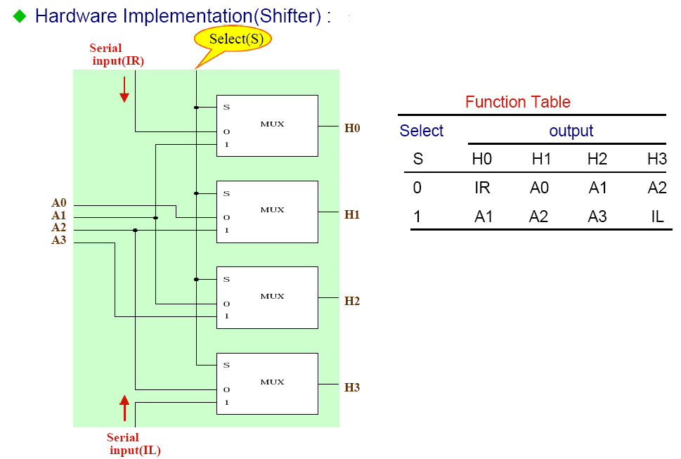
Register Transfer and Micro-operations <number>
Hardware Implementation of Shift Microoperation
CSE 211

Slide 16
Register Transfer and Micro-operations <number>
Arithmetic Logic and Shift Unit
S3
S2
C
i
S1
S0
Arithmetic
D
i
Circuit
Select
0
4 x 1
F
s2 | s3 | Operation
0 | 0 | Arithmetic
0 | 1 | Logical
1 | 0 | Shr
1 | 1 | shl
C
i
i+1
1
MUX
2
3
Logic
E
i
B
Circuit
i
A
i
A
shr
i-1
shl
A
i+1
CSE 211

